Slide 1

Machine Learning for Mortality Risk Prediction: A Study on Cohort Data
MEB Aging Epidemiology Group
Jim Jakobsson
Supervisors: Sara Hägg , Patrik Edén, & Anders Rantzer

Slide 2



Introduction and Background
 | Mortality risks increase with age, the complex interactions of other factors relative to age are less clear
 | Analysing comprehensive datasets could clarify those factors
 | Traditional statistical approaches, and humans, are limited in their ability to process high-dimensional data and detect non-linear patterns
Machine learning offers powerful advantages:
  Analyse all records simultaneously
  Identify key predictors of mortality
  Data-driven insights for personalised interventions

Slide 3
Aim of Study
The aim of the study is to apply machine learning to analyse SATSA, to identify patterns and predictors associated with mortality in aging adults
Research questions
1 | What are the strongest predictors for a 10 and 20 year mortality prediction among aging adults?
2 | Can tree-based supervised machine learning models accurately predict mortality risk using cohort data, without using synthetic imputations?

Slide 4
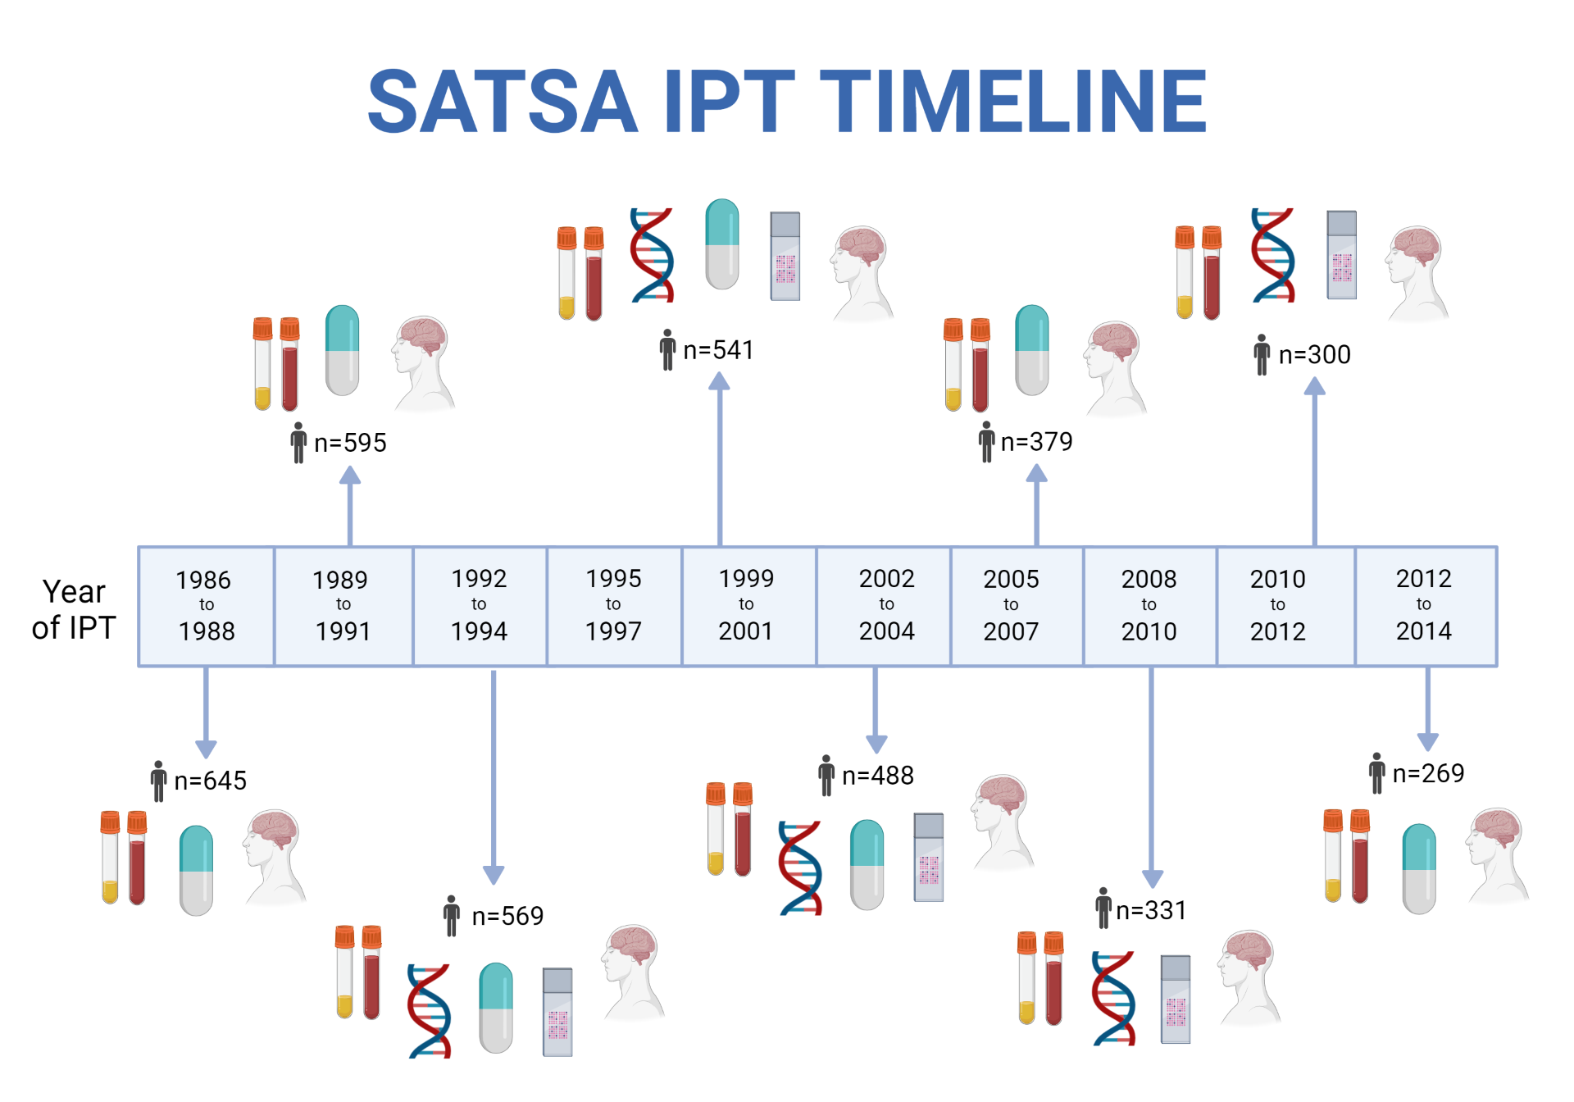
SATSA: The Swedish Adoption/Twin Study of Aging​
Longitudinal study of twins started in 1978
Unique focus on twins reared apart and together
Comprehensive health and cognitive assessments over 10 measurements, 30+ years
Data collected through:
  Questionnaires
  In-person tests
Strength: multiple domains included

Slide 5
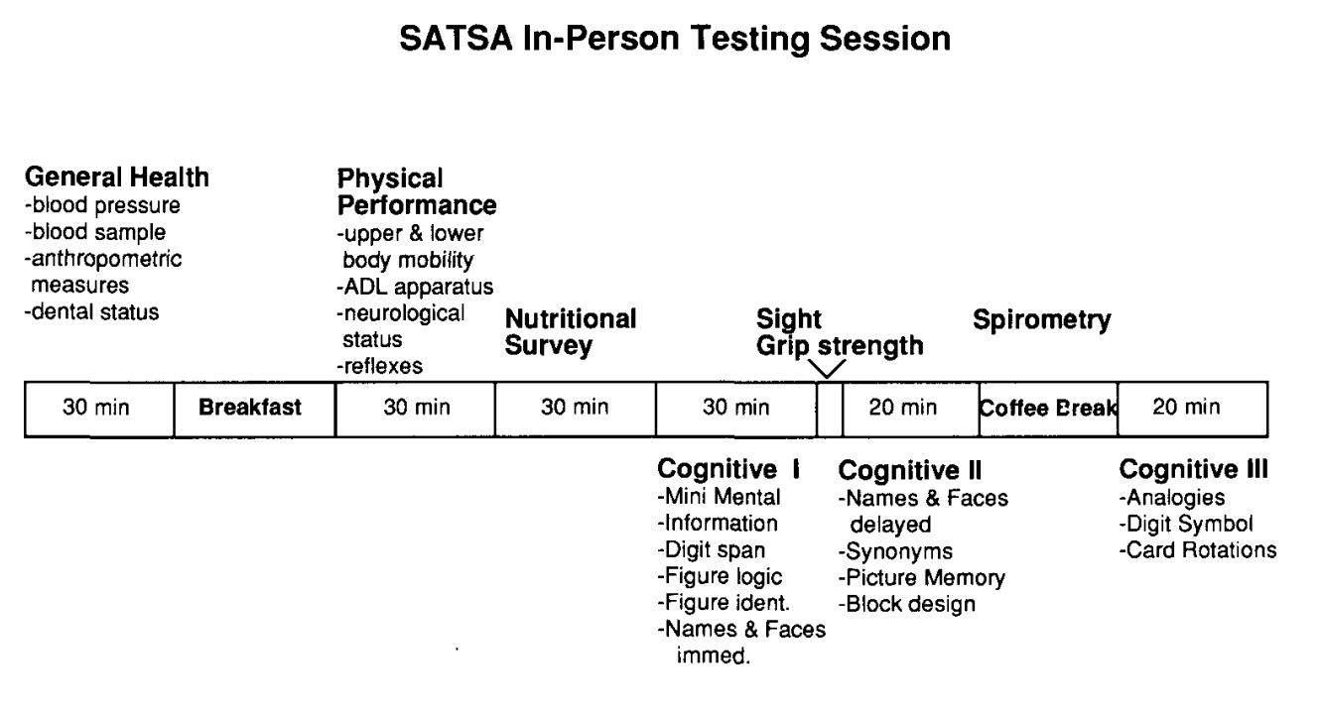
Description of In-Person Testing
Eligibility: Pairs where both responded to the first questionnaire, age 50+
First wave used: n=654, 423 variables
Comprehensive assessments:
  General health
  Physical performance
  Cognitive testing
Mean age: 63.9

Slide 6
Examples of Variables Collected in the Study
Cognitive Performance |  | Cardiovascular measurements |  | Respiratory function |  | Functional Abilities
Variable name | Variable description | Variable name | Variable description | Variable name | Variable description | Variable name | Variable description
asymb bsymb | Perceptual speed - identify corresponding digits for a series of symbols | bpsres | Blood pressure | fv1 | Forced expiratory volume, 1 second | strength | Grip strength
face1 | Correctly identify previously viewed faces | tg1 | Triglycerides | fvc | Forced vital capacity | activities of daily living | Screw in a lightbulb, rotary telephone, put coins into slots
arottot | Spatial ability – card rotations. Determine if card is rotated compared to reference | sedim | Erythrocyte sedimentation rate | kvotvc | Ratio fv1/fvc

Slide 7

Main Challenges with SATSA Dataset
SATSA offers a valuable opportunity to discover contributions to aging, however:
 | It is a dataset containing vast amounts of data
 | Complex interactions between 400+ variables
 | Several missing values
 | Identification and handling of continuous/categorical variables
 | Traditional statistics require pre-defined assumptions
 | Scale too large to handle manually

Slide 8






Advantages of Supervised Machine Learning
 | Algorithms that can make predictions or decisions without being explicitly programmed for every scenario
 | Automatically discovers patterns in complex data, comparing attributes of different classes: survived/deceased
 | Can handle high-dimensional datasets
 | Identify subtle interactions between variables
 | Prioritises the most important factors
 | Learns which combinations of factors are linked to longer or shorter lifespan

Slide 9
Methodology
 | Step | Description
1 | Created a labeled dataset from SATSA | Tracked survival status at 10/20 years after IPT1 Labeled each participant: survived(0)/deceased(1)
2 | Transformed missing data into insights | Missing tests may signal health status Binary indicator variables introduced (missing/not missing)
3 | No synthetical imputation of missing values | Common practice to impute, sensitivity analysis needed All results are grounded in actual observations
4 | Standardised variables | Converted continous values to range between 0 and 1 Categorical variables encoded with one-hot encoding
5 | Applied machine learning models | Used tree-based models that can handle missing data Combined multiple models for better predictions
6 | Trained the models on the data using Tensor | Computationally expensive, cannot be done on a laptop Using 96 cores, Tensor required 10-45 minutes
7 | Interpreted results | Performance metrics used: AUC, accuracy, F1 score Quantified importance of each variable using the framework SHAP

Slide 10
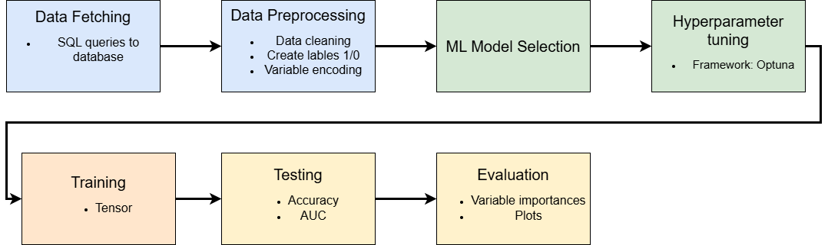
Flowchart of Data

Slide 11
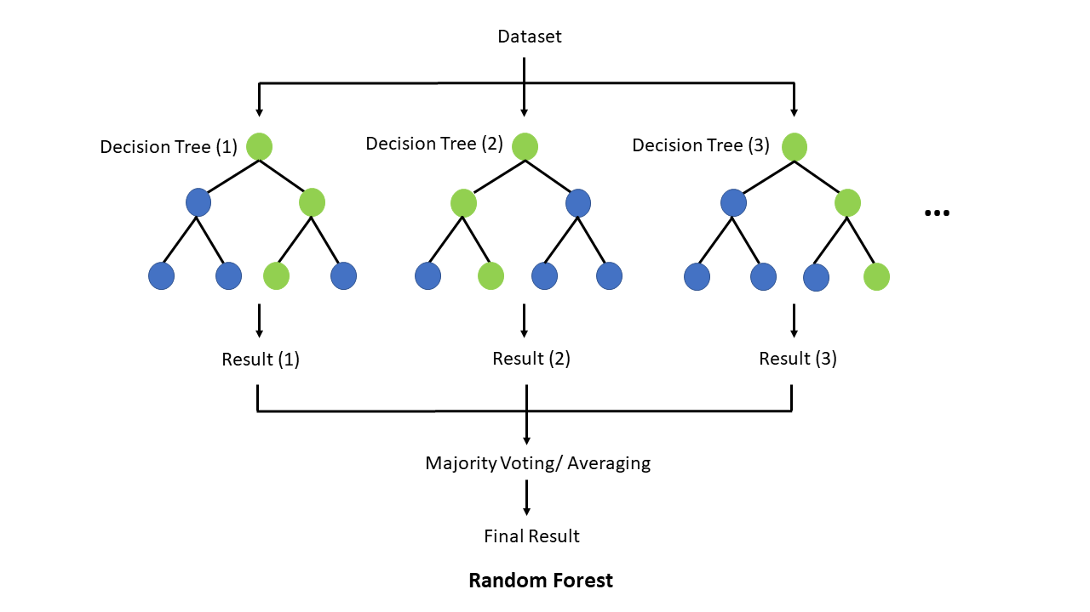
Random Forest Classifier
Combines many decision trees
  Each tree learns from different health measurements
  Trees vote on mortality probability
  Final prediction based on fraction of positive outcomes
Great performance
  Handles missing data natively
  Can capture complex, non-linear relations
  Robust to outliers
  Robust to overfitting

Slide 12
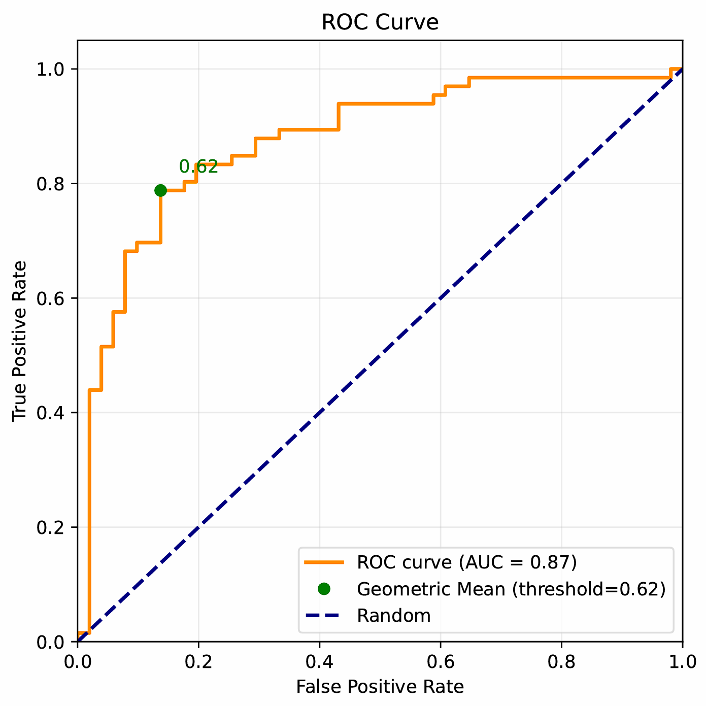
Model Performance
20-year prediction
  Balanced dataset
    56% deceased, 44% survived
  Accuracy: 0.81, AUC: 0.87
10-year prediction
  Unbalanced dataset
    27% deceased, 73% survived
  Accuracy: 0.73, AUC: 0,79
Geometric mean and class weights used to balance data
  No synthetic data used
ROC and AUC for a 20-year prediction, using a Random Forest

Slide 13
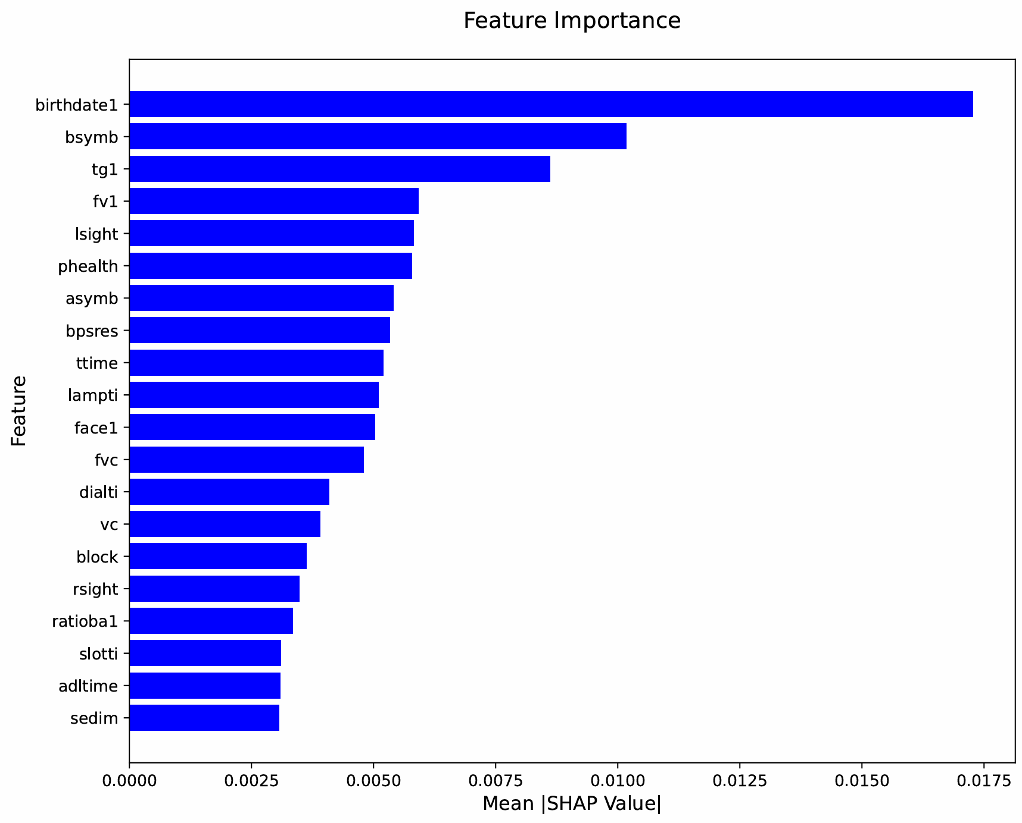
Key Variables 20-year Mortality Prediction
Cognitive performance
  Perceptual speed, asymb & bsymb
Triglyceride levels
  Tg1
  From excess calories
  Elevates risk for diabetes, strokes
Respiratory functionality
  Forced expiratory volume, fv1
  Forced vital capacity, fvc
  Vital capacity, vc
Vision assessments
  lsight & rsight
Blood pressure
  Systolic, bpsres

Slide 14
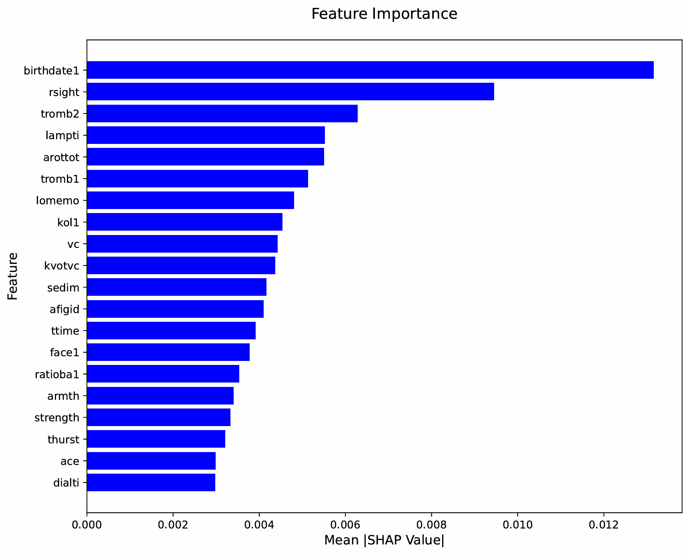
Key Variables 10-year Mortality Prediction
Focused on cardiovascular measurements
  Thrombocyte numbers, tromb1 & tromb2
  Cholesterol levels, kol1
  Erythrocyte (red blood cells) sedimentation rate, sedim
  Apolipoprotein B/A, ratioba1
Functional assessments
  Fine motor skills, lampti
  Grip strength, strength
Long-term memory difficulties
  lomemo

Slide 15
Common Key Predictors 10/20 years
Age
  birthdate1
Ratio apolipoprotein B/A
  Ratioba1
  Carries cholesterol in the blood
Vision assessments
  lsight & rsight
Face recognition
  face1
Vital capacity
  vc
Key variables 10-year mortality prediction

Slide 16
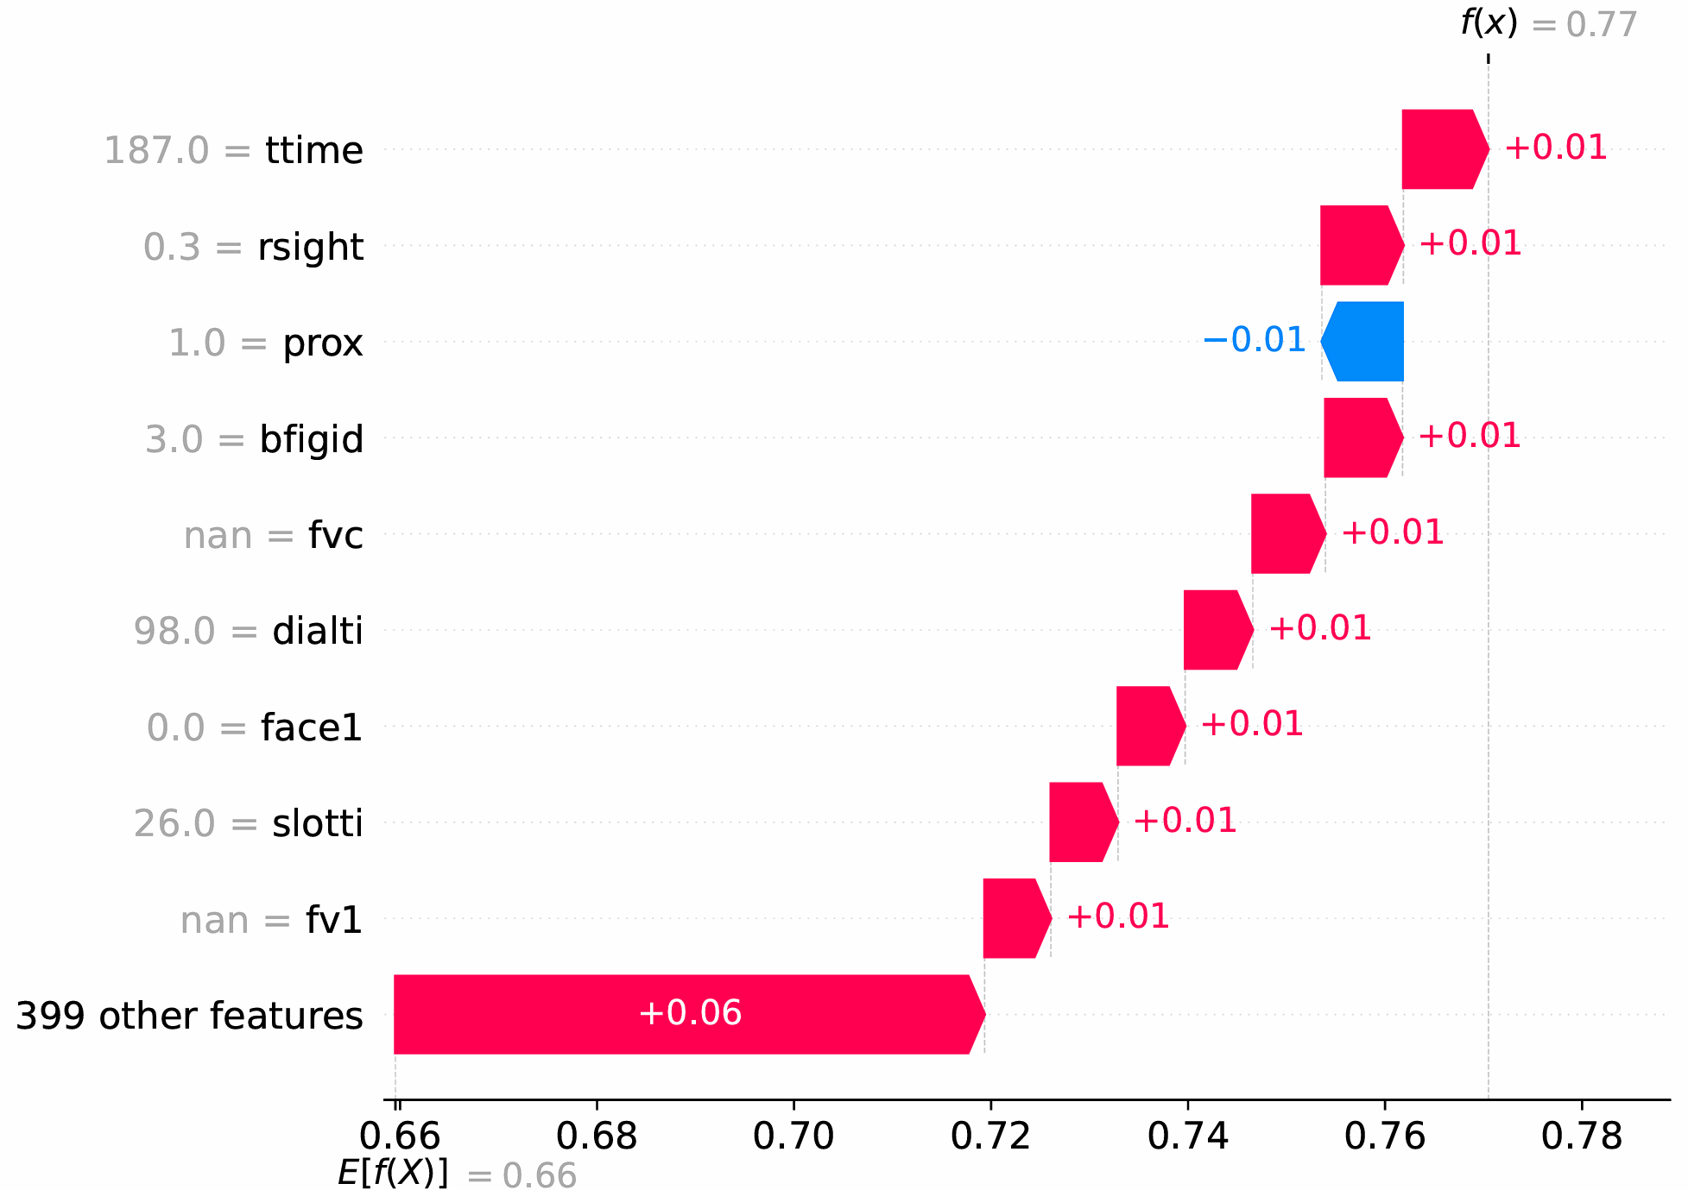
Individualised Risk Assessment
Variable contributions for one person
Individual 10-year Mortality Risk Assessment: 77%
Age not a significant factor
Slow at the functional tests
  Ttime, dialti, slotti
Poor vision
  rsight
Good proximal muscle function
  Prox
  Lowers mortality risk
Missing values for lung measurements
  Fvc, fv1
Low scores in cognitive test
  Bfigid: figure identification
  Face1: face recognition

Slide 17
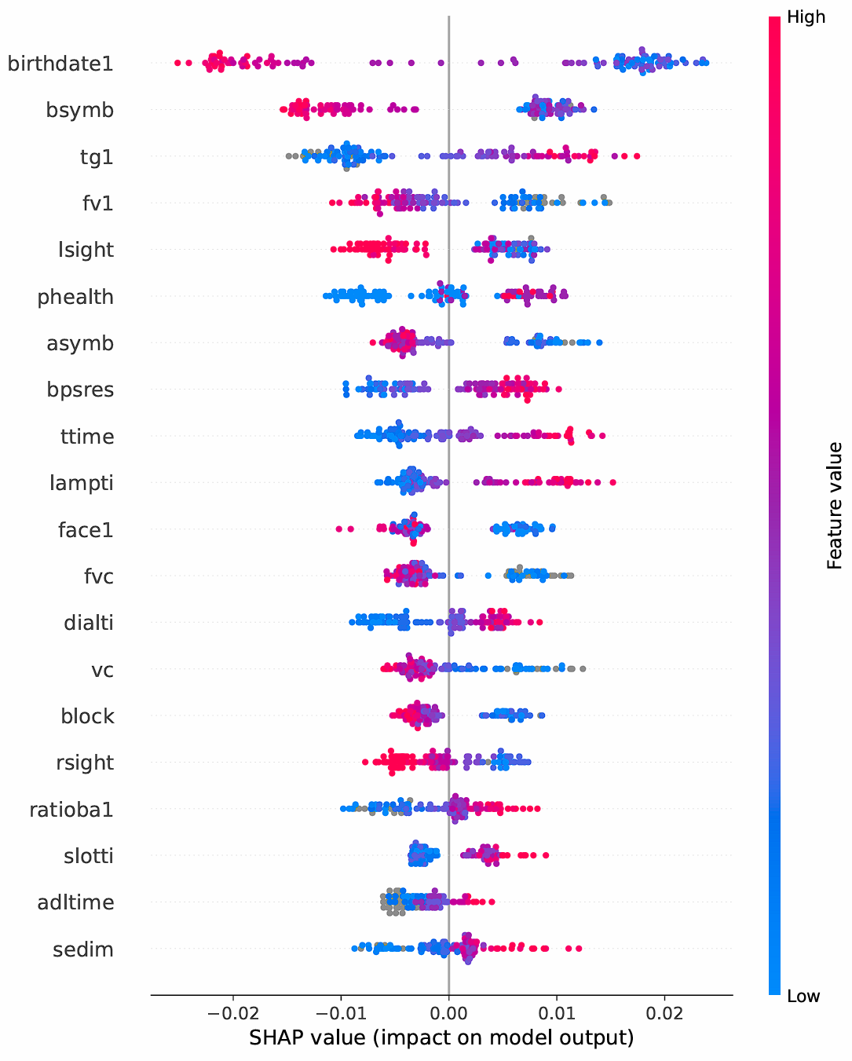
Value Distribution
Summary plot for a 20-year mortality prediction
Shows a measurement’s impact on mortality risk
  Red = high values, blue = low values
Position shows if factor increases (right) or decreases (left) risk
High sedimentation rate (sedim) as significant as blood pressure
Low vital capacity (vc) significant
Low scores in asymb & bsymb significant
High time for lamp insertion (lampti) significant

Slide 18
Conclusions
Significant for a
20-year mortality prediction*
Cognitive performance:
  Perceptual speed
  Spatial ability
Metabolic measurement:
  Triglyceride levels
Blood pressure
Significant for a
10-year mortality prediction
Cardiovascular measurements:
  Thrombocyte counts
  Cholesterol levels
  Erythrocyte sedimentation rate
Functional assessments:
  Grip strength
  Fine motor skills
Long-term memory difficulties
Significant across both prediction windows
Age
Vision
Apolipoprotein
Facial recognition
Respiratory function
* Symbolises degenerative factors

Slide 19
Limitations to Study
Single time-point measurement
  Missing health trajectories over time
  Future work: include all measurements from all IPTs
No imputation or use of synthetic data
  Limited to tree-based ML models
  Unable to balance data sets using synthetic data
  Future work: imputation with sensitivity analysis
Little feature engineering
  Almost every variable is in the training data
  Future work: reduce to domain specific features to improve accuracy

